Slide 1

Motion Priors for Pose Estimation and Animation Workflows
Luke Smith

Slide 2
Introduction & Motivation

Slide 3
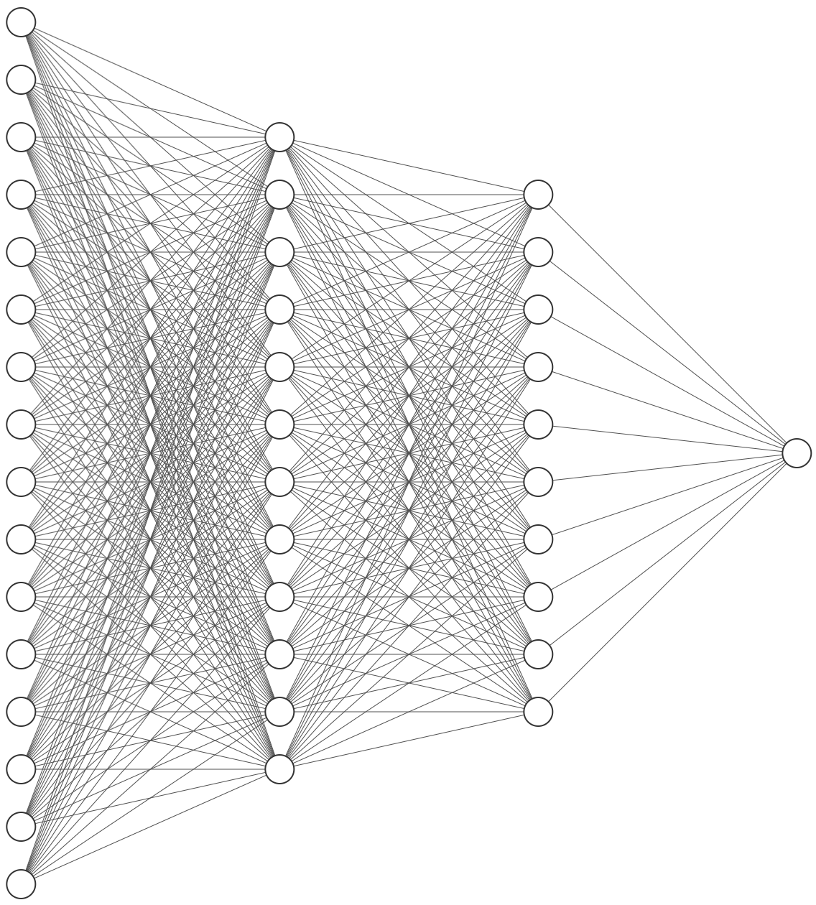
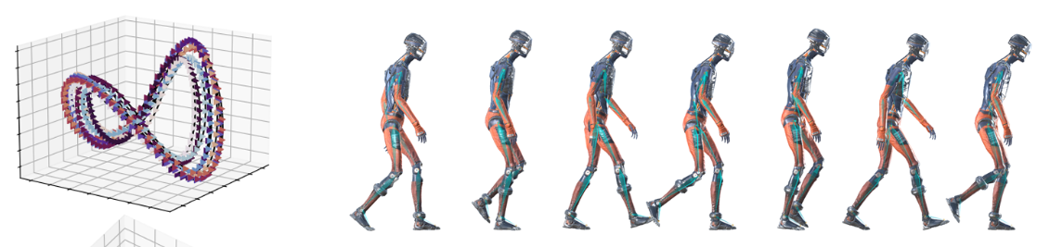
Motion Priors
A model that has learnt how humans move
Image from [SMK22]
Notes:
Value I provided:
Showed HuMoR is difficult & saved time & money for disney
Diffusion
Laid foundation of code for animation group to work on

Slide 4
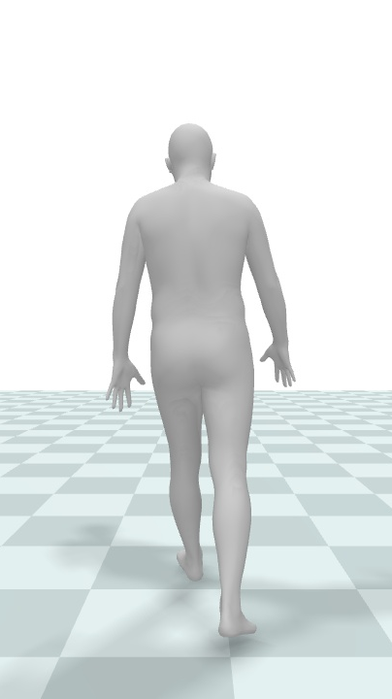
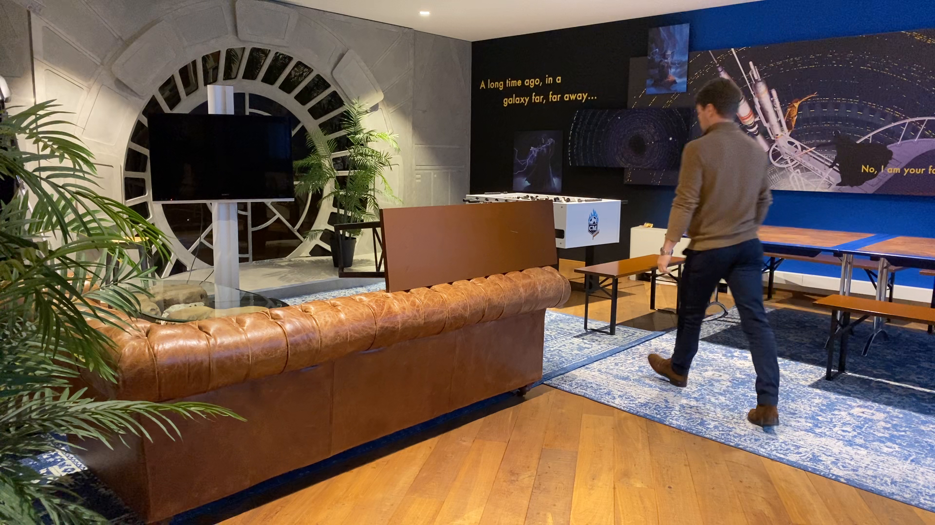
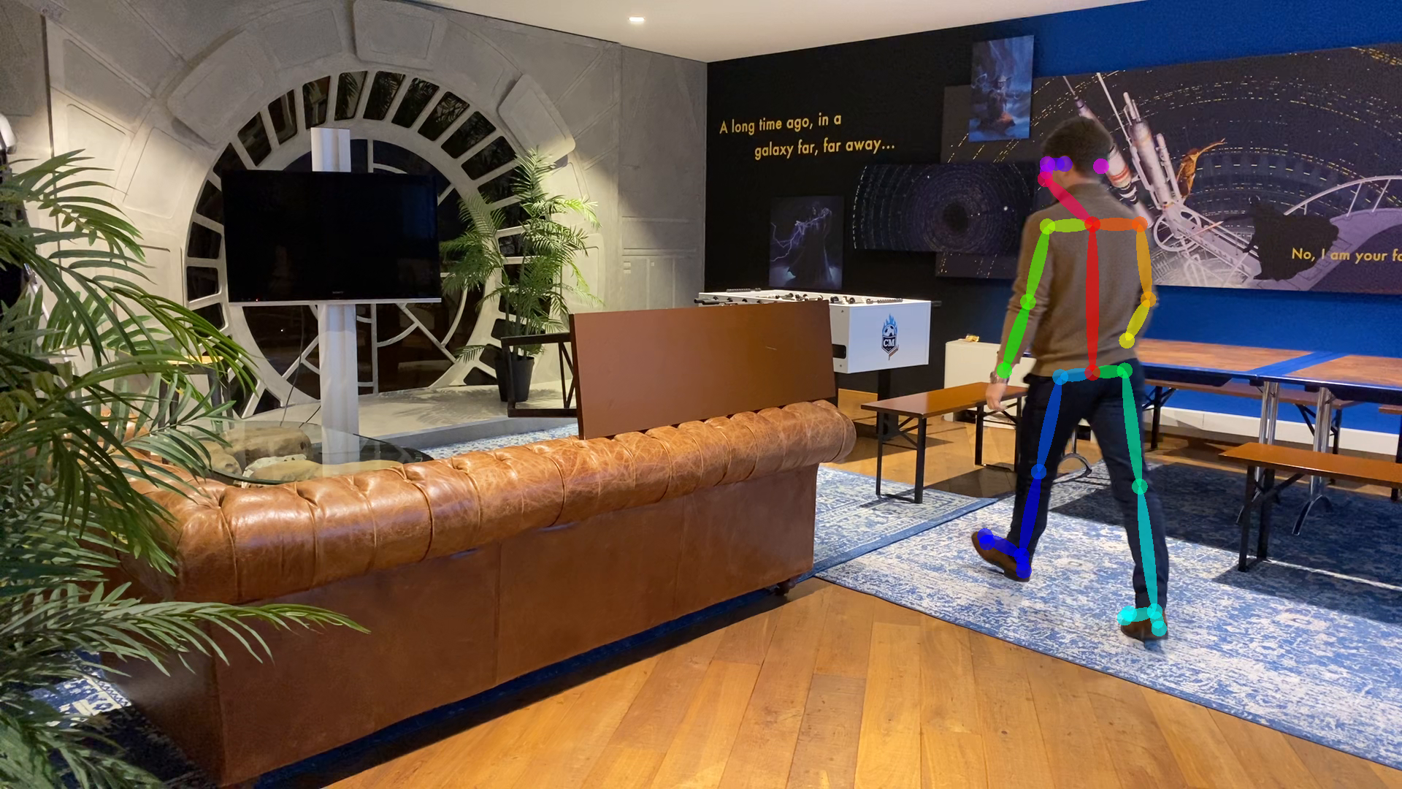
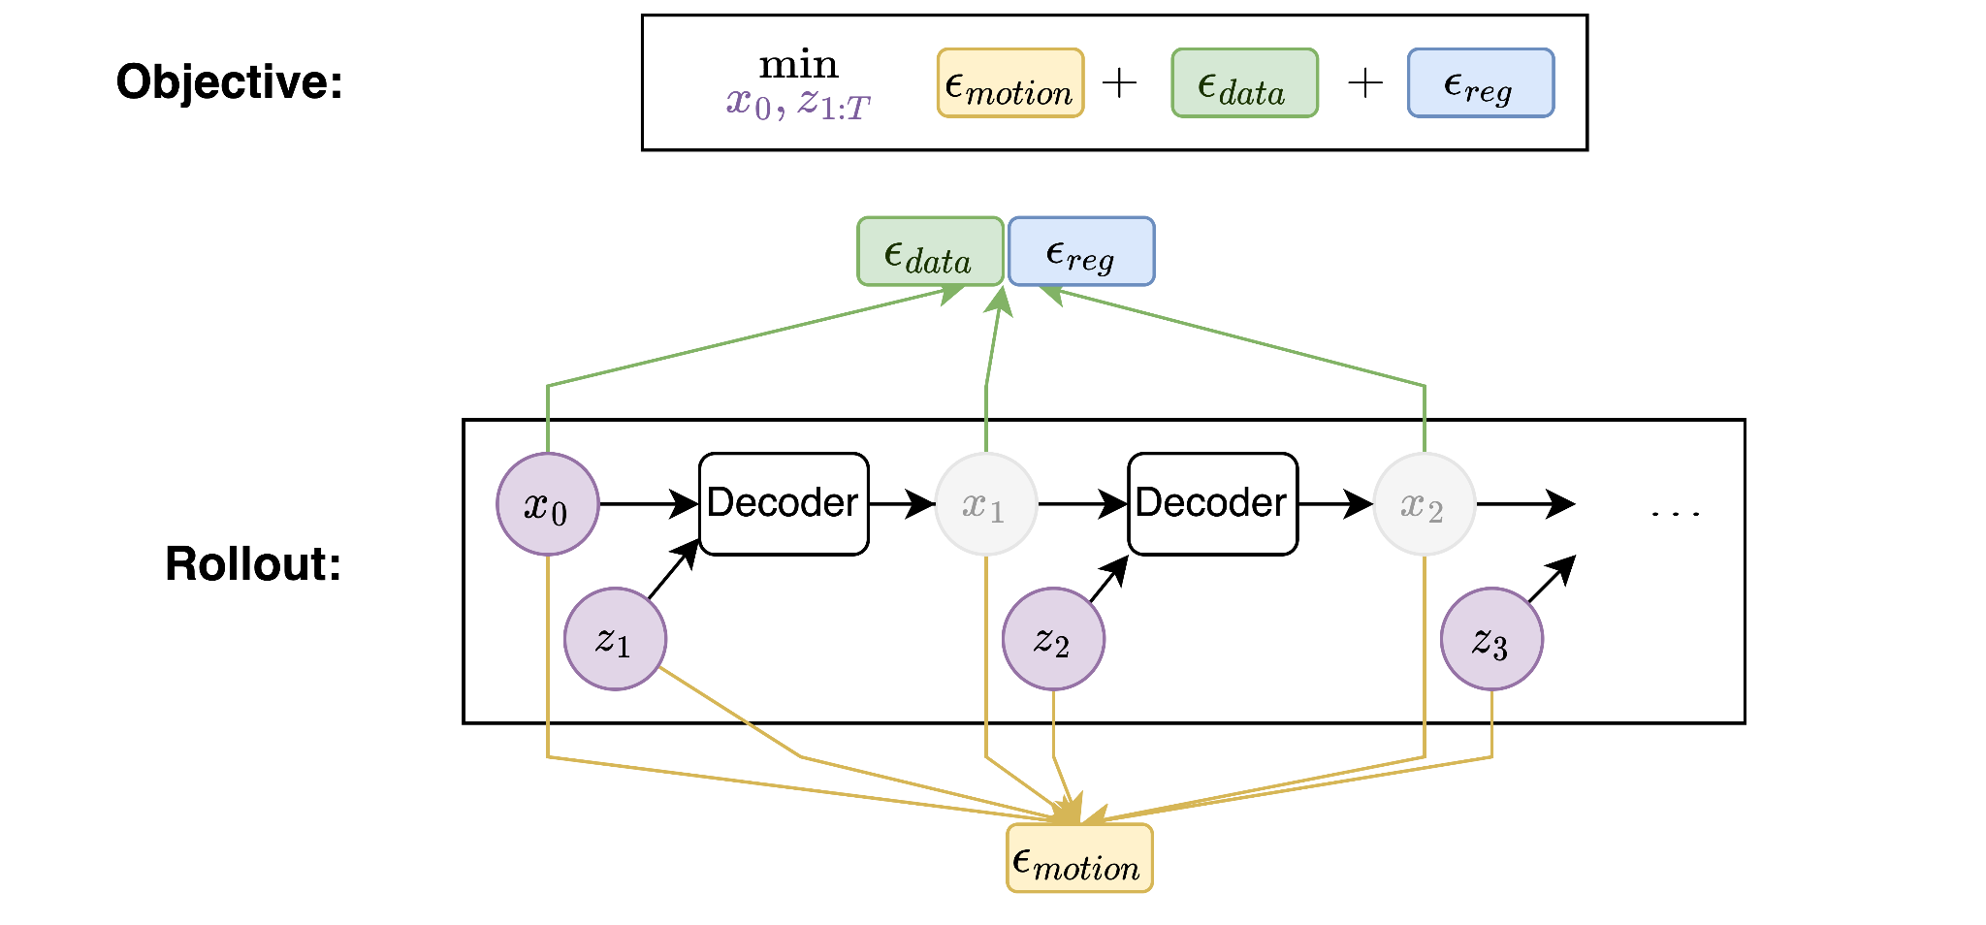
Motion Capture
+
Motion Prior
Notes:
Value I provided:
Showed HuMoR is difficult & saved time & money for disney
Diffusion
Laid foundation of code for animation group to work on

Slide 5
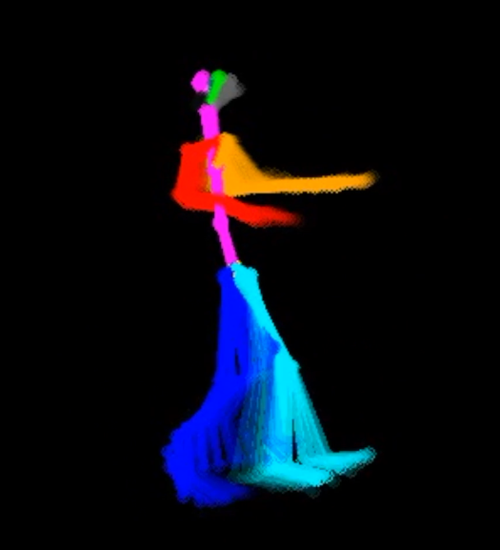
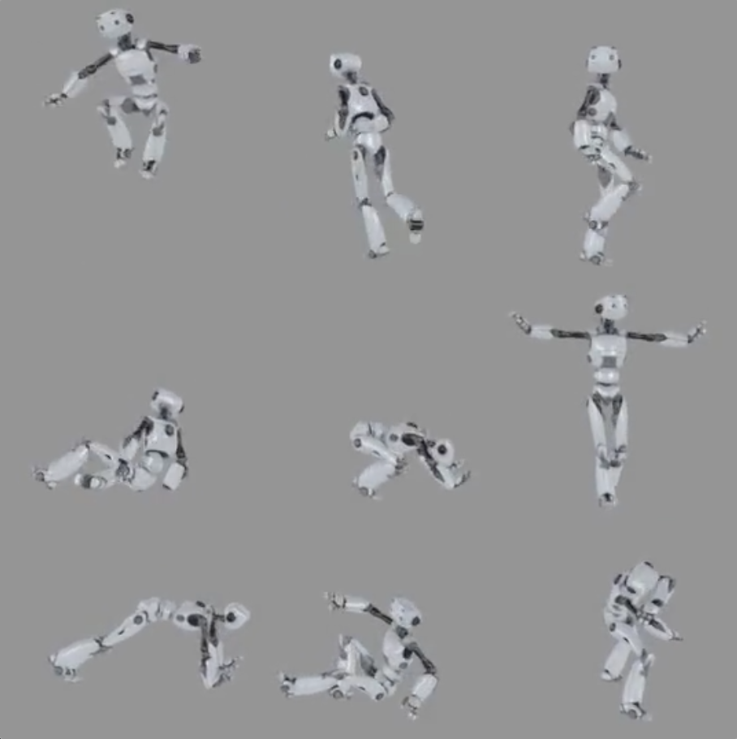
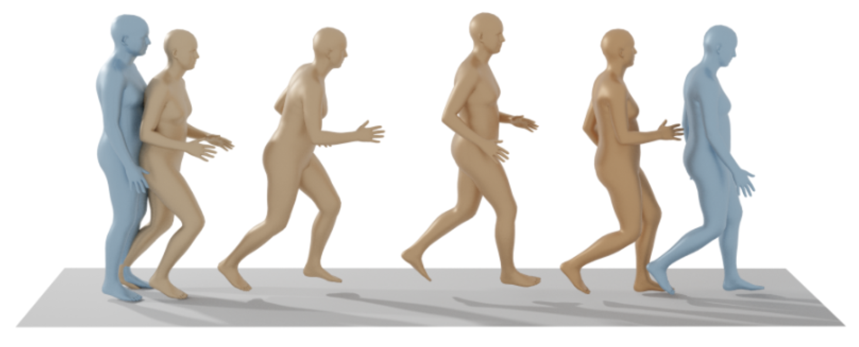
Other uses
Inbetweening
Generation
Rectification
Image from [TRG+22]
Notes:
Value I provided:
Showed HuMoR is difficult & saved time & money for disney
Diffusion
Laid foundation of code for animation group to work on

Slide 6
Related Work

Slide 7
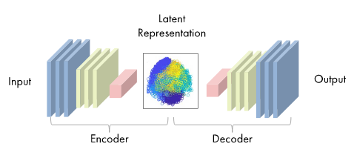
Autoencoders & VAEs
Image from https://www.mathworks.com/discovery/autoencoder.html
Notes:
Value I provided:
Showed HuMoR is difficult & saved time & money for disney
Diffusion
Laid foundation of code for animation group to work on

Slide 8
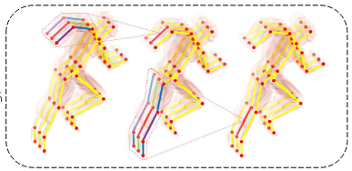
Autoencoders & VAEs
Skeletal Convolutions
Periodic latent space
HM-VAE
[LVC+ 21]
DeepPhase
[SMK22]
Notes:
Value I provided:
Showed HuMoR is difficult & saved time & money for disney
Diffusion
Laid foundation of code for animation group to work on

Slide 9
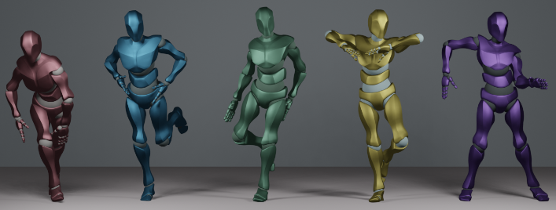
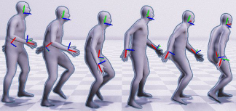
Diffusion
Music → motion
Sparse → complete
EDGE
[TCL22]
Avatars Grow Legs
[DKP+23]
Notes:
Value I provided:
Showed HuMoR is difficult & saved time & money for disney
Diffusion
Laid foundation of code for animation group to work on

Slide 10
What was our approach?
Part 1: Pose estimation
Goal: Auto mo-cap
Evaluate and extend HuMoR
Part 2: Animation workflows
Goal: General motion prior
Investigate diffusion
Notes:
Value I provided:
Showed HuMoR is difficult & saved time & money for disney
Diffusion
Laid foundation of code for animation group to work on

Slide 11
Part 1: HuMoR

Slide 12
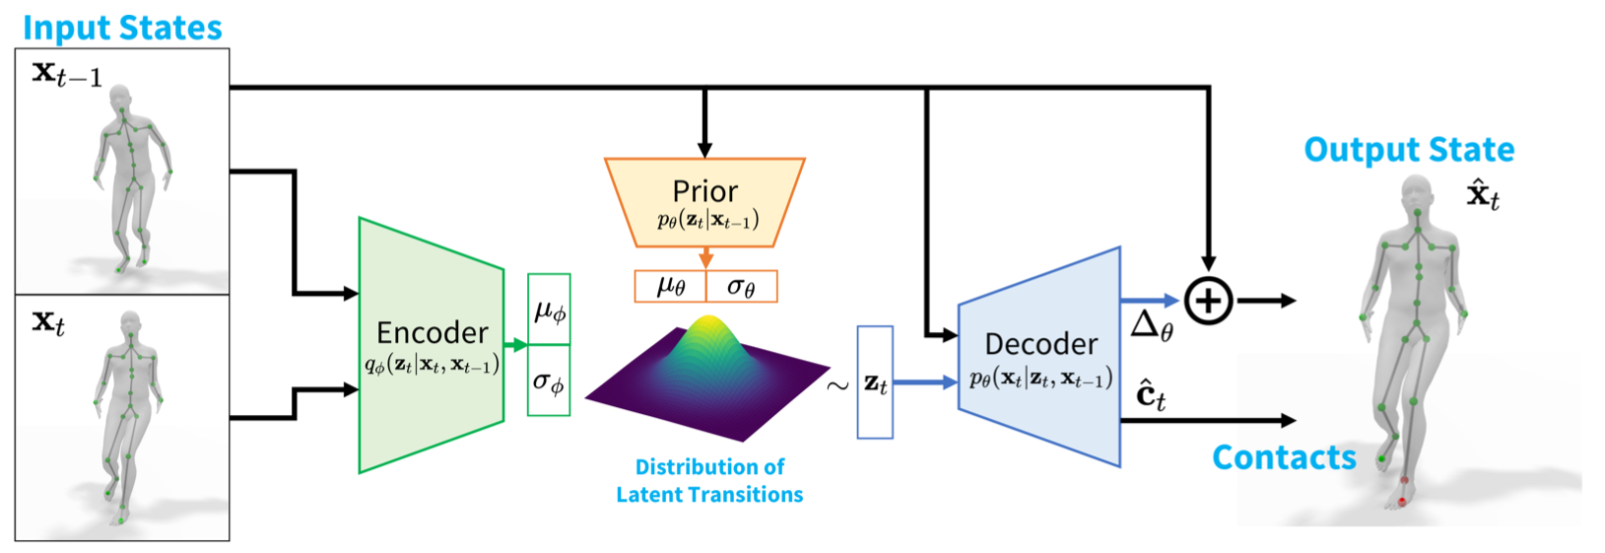
HuMoR Paper
Motion prior
Motion improving optimiser
Image adapted from [RBH+21]
Notes:
Value I provided:
Showed HuMoR is difficult & saved time & money for disney
Diffusion
Laid foundation of code for animation group to work on

Slide 13
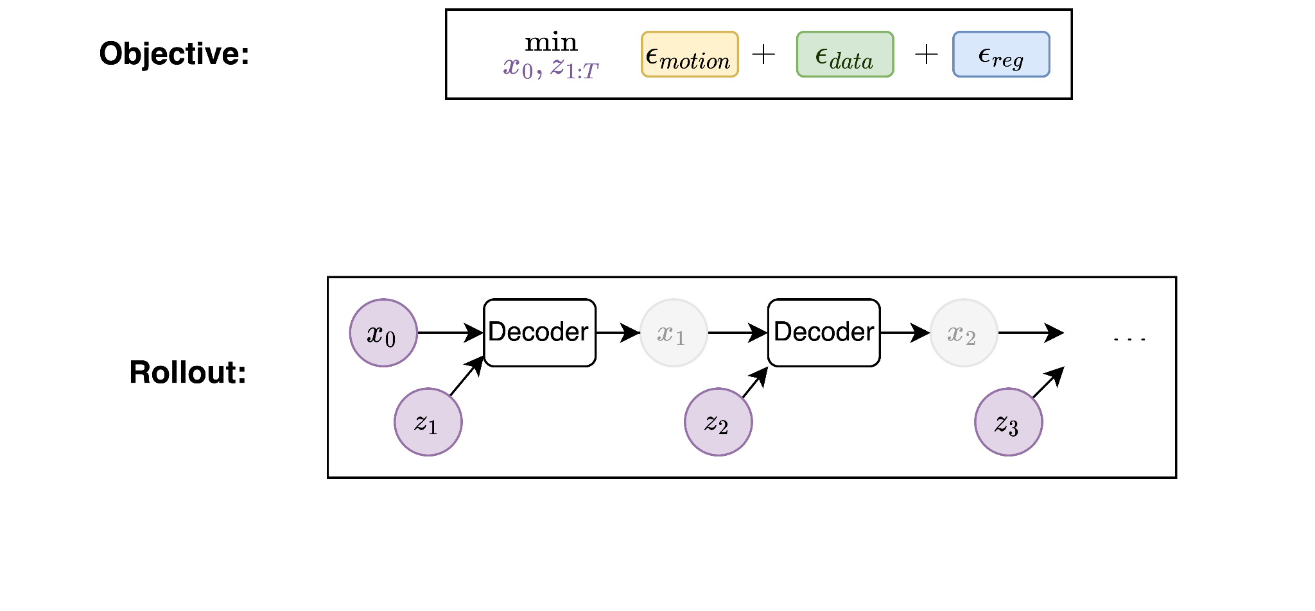
HuMoR Paper
Motion prior
Motion improving optimiser
Image adapted from [RBH+21]
Notes:
Value I provided:
Showed HuMoR is difficult & saved time & money for disney
Diffusion
Laid foundation of code for animation group to work on

Slide 14
Optimisation
Optimise initial pose + latent transitions
Notes:
Value I provided:
Showed HuMoR is difficult & saved time & money for disney
Diffusion
Laid foundation of code for animation group to work on

Slide 15
Optimisation
Each step: rollout
Notes:
Value I provided:
Showed HuMoR is difficult & saved time & money for disney
Diffusion
Laid foundation of code for animation group to work on

Slide 16
Optimisation
Apply losses to rollout
Motion Prior
Notes:
Value I provided:
Showed HuMoR is difficult & saved time & money for disney
Diffusion
Laid foundation of code for animation group to work on

Slide 17
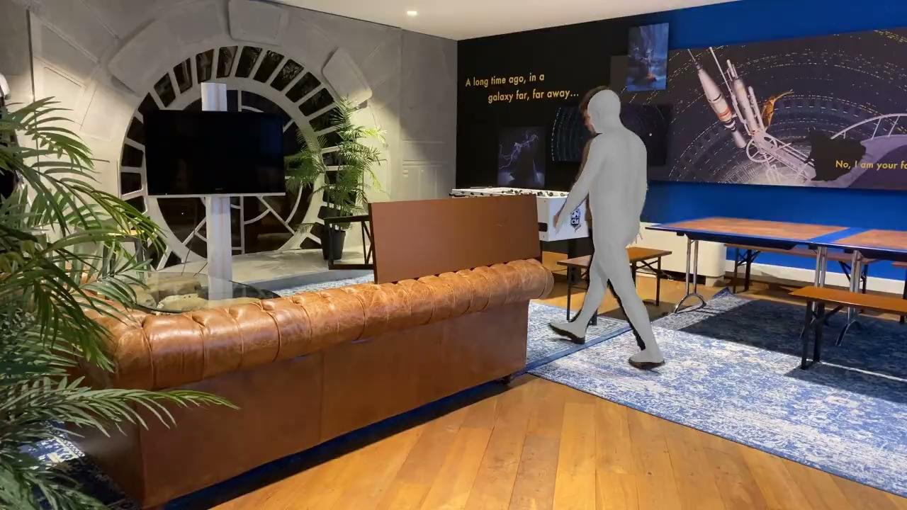
Optimisation - Good
Notes:
Value I provided:
Showed HuMoR is difficult & saved time & money for disney
Diffusion
Laid foundation of code for animation group to work on

Slide 18
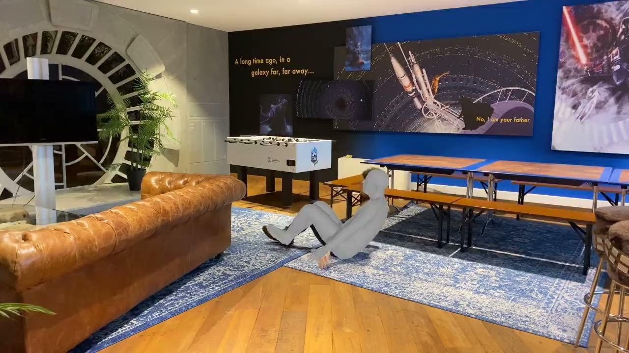
Optimisation - Bad
Notes:
Value I provided:
Showed HuMoR is difficult & saved time & money for disney
Diffusion
Laid foundation of code for animation group to work on

Slide 19
Investigation Conclusion
✅ Promising results
❌ Issues due to rollout
Error accumulation
Slow! - 20mins for 8s video
Next: improvement
Notes:
Value I provided:
Showed HuMoR is difficult & saved time & money for disney
Diffusion
Laid foundation of code for animation group to work on

Slide 20
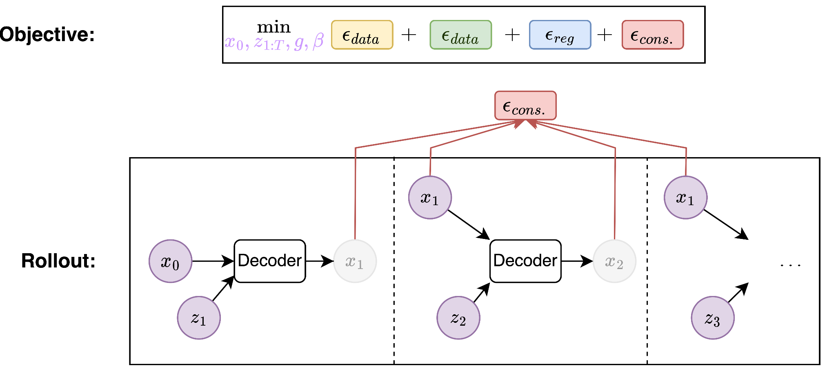
Break the rollout!
2
Notes:
Value I provided:
Showed HuMoR is difficult & saved time & money for disney
Diffusion
Laid foundation of code for animation group to work on

Slide 21
Break the rollout!
2
Notes:
Value I provided:
Showed HuMoR is difficult & saved time & money for disney
Diffusion
Laid foundation of code for animation group to work on

Slide 22
How did it go?
✅ Improvements
Faster
More scalable
❌ Lower performance
Trouble with error propagation
Difficult to balance
Notes:
Value I provided:
Showed HuMoR is difficult & saved time & money for disney
Diffusion
Laid foundation of code for animation group to work on

Slide 23
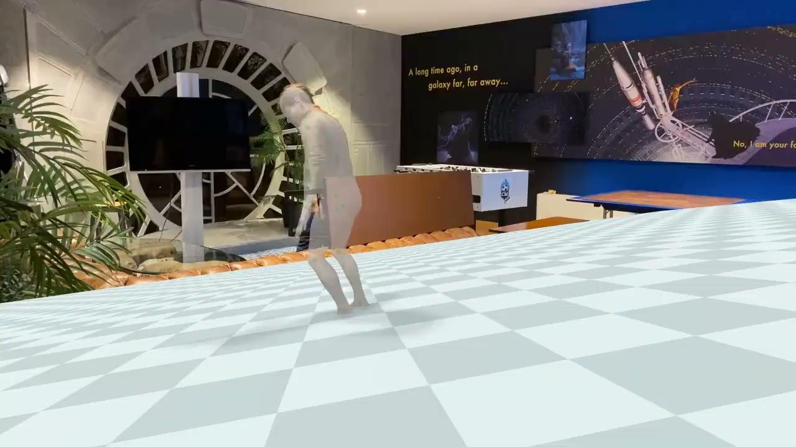
Error propagation
Notes:
Value I provided:
Showed HuMoR is difficult & saved time & money for disney
Diffusion
Laid foundation of code for animation group to work on

Slide 24
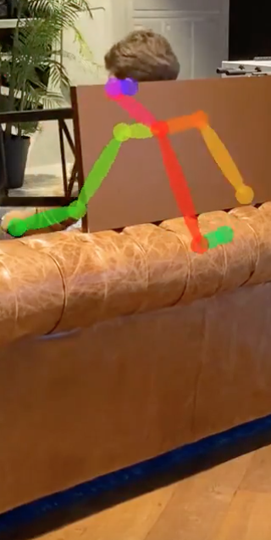
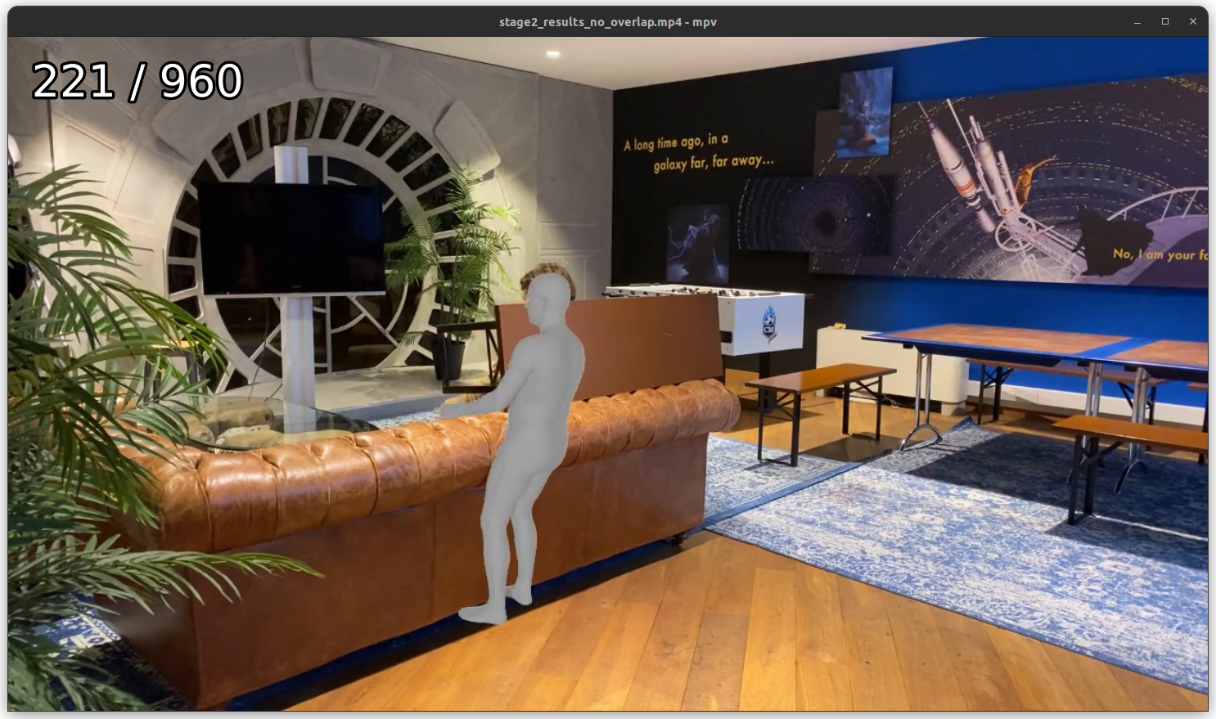
Fighting losses
Notes:
Value I provided:
Showed HuMoR is difficult & saved time & money for disney
Diffusion
Laid foundation of code for animation group to work on

Slide 25
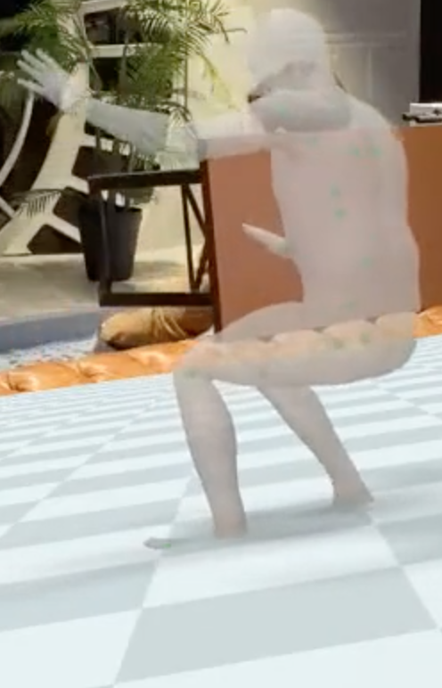
Fighting losses
Notes:
Value I provided:
Showed HuMoR is difficult & saved time & money for disney
Diffusion
Laid foundation of code for animation group to work on

Slide 26
Fighting losses
Notes:
Value I provided:
Showed HuMoR is difficult & saved time & money for disney
Diffusion
Laid foundation of code for animation group to work on

Slide 27
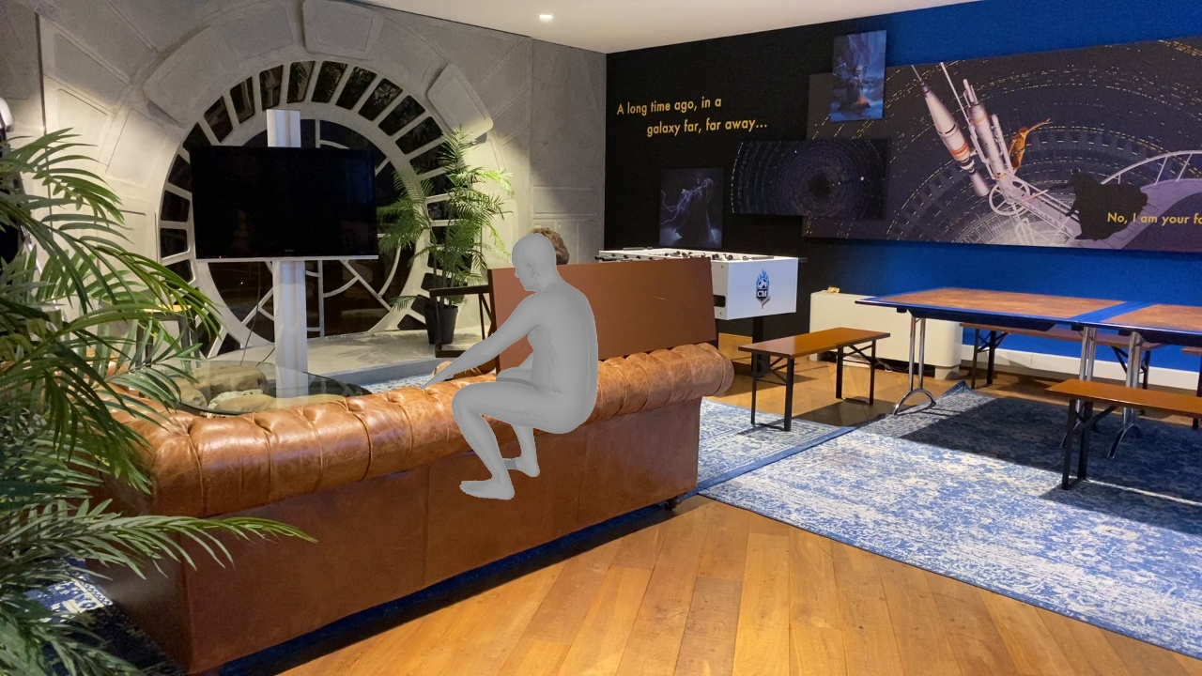
Fighting losses
Sit Down (+ arm up)
Notes:
Value I provided:
Showed HuMoR is difficult & saved time & money for disney
Diffusion
Laid foundation of code for animation group to work on

Slide 28
Fighting losses
Arm down
(+ stand up…)
Notes:
Value I provided:
Showed HuMoR is difficult & saved time & money for disney
Diffusion
Laid foundation of code for animation group to work on

Slide 29
Fighting losses
Arm down
(+ stand up…)
Detach?
Notes:
Value I provided:
Showed HuMoR is difficult & saved time & money for disney
Diffusion
Laid foundation of code for animation group to work on

Slide 30
Conclusion - HuMoR
❌ Autoregression is slow
❌ Optimising a global sequence with local
updates is tough → no gains
✅ Next → sequence level models
Notes:
Value I provided:
Showed HuMoR is difficult & saved time & money for disney
Diffusion
Laid foundation of code for animation group to work on

Slide 31
Part 2: Motion Diffusion Models

Slide 32
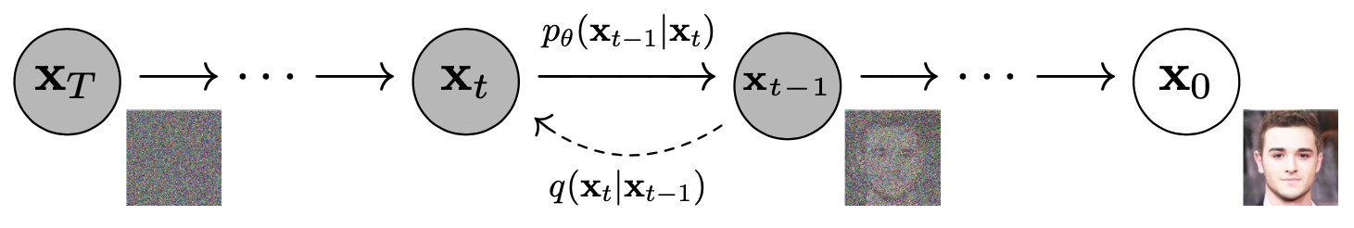
Diffusion
Commonly for images
Image from [HJA20]
Notes:
Value I provided:
Showed HuMoR is difficult & saved time & money for disney
Diffusion
Laid foundation of promising diffusion code for animation group to work with

Slide 33
Diffusion
Deterministic noising function
Image from [HJA20]
Notes:
Value I provided:
Showed HuMoR is difficult & saved time & money for disney
Diffusion
Laid foundation of promising diffusion code for animation group to work with

Slide 34
Diffusion
Learned denoising function
Deterministic noising function
Image from [HJA20]
Notes:
Value I provided:
Showed HuMoR is difficult & saved time & money for disney
Diffusion
Laid foundation of promising diffusion code for animation group to work with

Slide 35
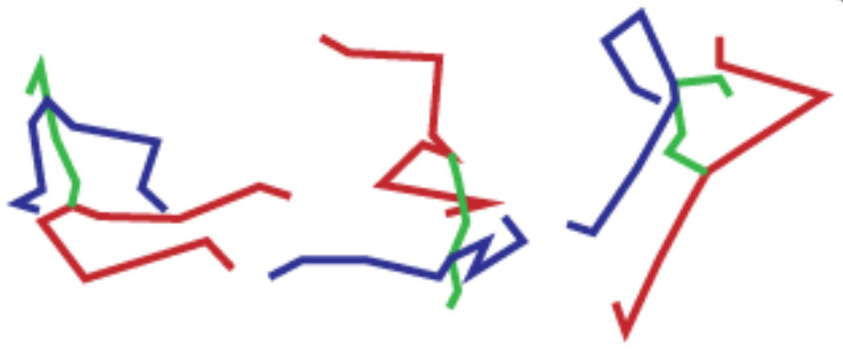
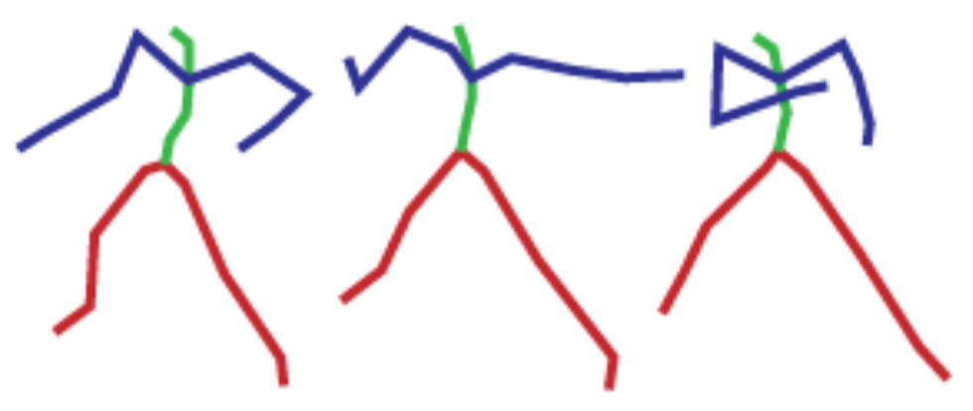
Motion Diffusion
Images adapted from from [HJA20] and [TCL22]
Notes:
Value I provided:
Showed HuMoR is difficult & saved time & money for disney
Diffusion
Laid foundation of promising diffusion code for animation group to work with

Slide 36
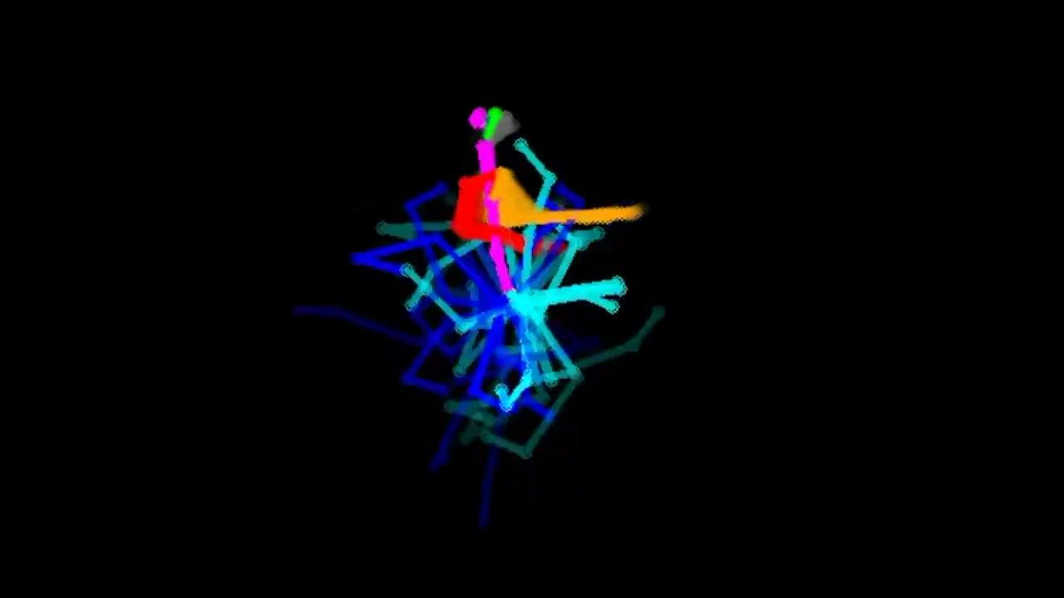
Inpainting
Each denoising step
Partially overwrite with known motion
Notes:
Value I provided:
Showed HuMoR is difficult & saved time & money for disney
Diffusion
Laid foundation of code for animation group to work on

Slide 37
Test Cases
Generation
Random missing joints
Occluded legs
Inbetweening
And more…
Notes:
Value I provided:
Showed HuMoR is difficult & saved time & money for disney
Diffusion
Laid foundation of code for animation group to work on

Slide 38

Generation
✅
- Diverse motion
❔
- Overfit to training
data?
Notes:
Value I provided:
Showed HuMoR is difficult & saved time & money for disney
Diffusion
Laid foundation of code for animation group to work on

Slide 39
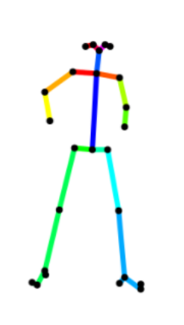
Missing Joints - 1
Each frame, remove 75% of joints
❌
❌
❌
❌
❌
❌
❌
❌
❌
Frame 1
Frame 2
Frame 3
Notes:
Value I provided:
Showed HuMoR is difficult & saved time & money for disney
Diffusion
Laid foundation of code for animation group to work on

Slide 40
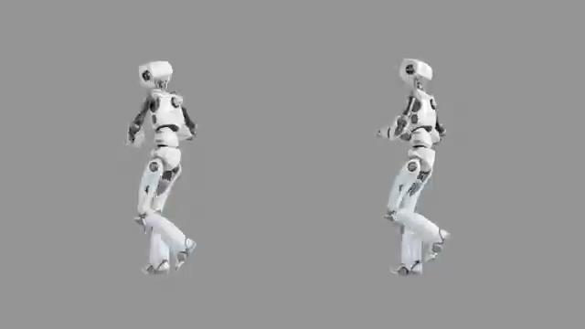
Missing Joints - 1
✅
- Good motion
- Temporal consistency
❌
- Arms changed
- Foot sliding
❔
- Would interpolation
work just as well?
Ground truth
Replaced missing joints
Notes:
Value I provided:
Showed HuMoR is difficult & saved time & money for disney
Diffusion
Laid foundation of code for animation group to work on

Slide 41
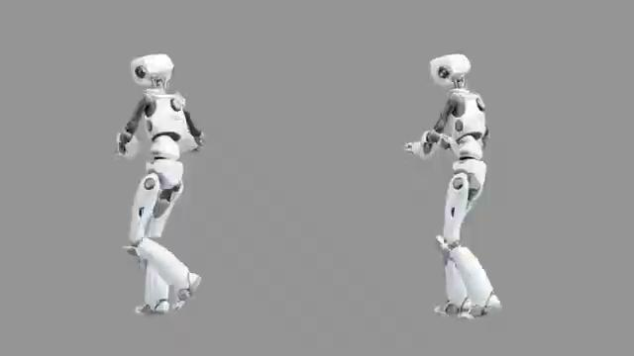
Occluded Legs
✅
- Decent leg motion
❌
- Foot sliding
- Occasional reversed
motion
❔
- Global root
- Foot contacts
Ground truth
Replaced missing legs
Notes:
Value I provided:
Showed HuMoR is difficult & saved time & money for disney
Diffusion
Laid foundation of code for animation group to work on

Slide 42
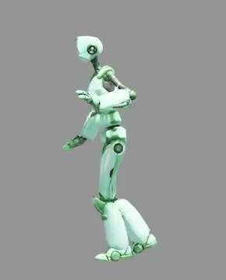
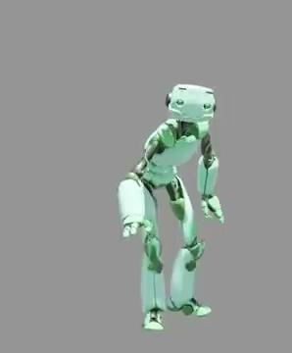
Inbetweening
✅
- Plausible motion
❌
- Uncorrelated
- Jumps!
Notes:
Value I provided:
Showed HuMoR is difficult & saved time & money for disney
Diffusion
Laid foundation of code for animation group to work on

Slide 43
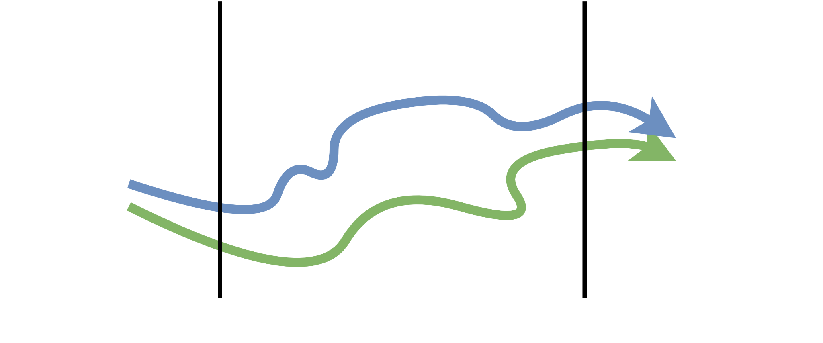
Inbetweening
Denoised
Known
Notes:
Value I provided:
Showed HuMoR is difficult & saved time & money for disney
Diffusion
Laid foundation of code for animation group to work on

Slide 44
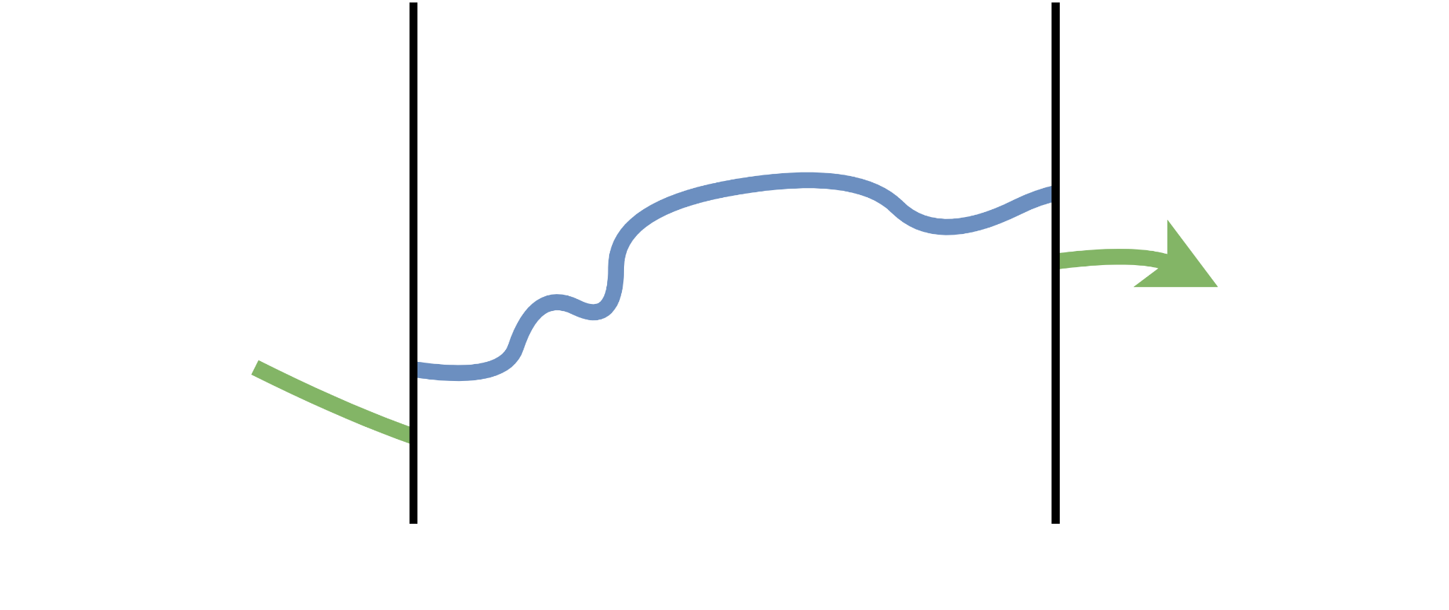
Inbetweening
Notes:
Value I provided:
Showed HuMoR is difficult & saved time & money for disney
Diffusion
Laid foundation of code for animation group to work on

Slide 45
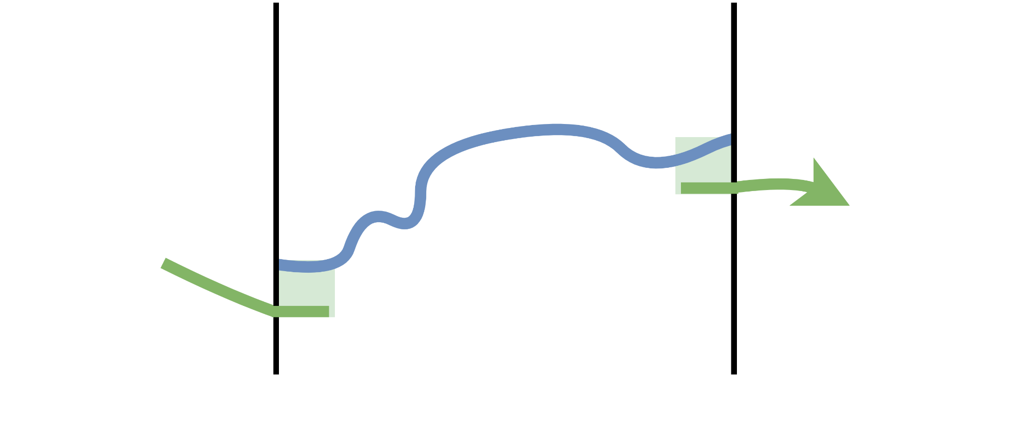
Inbetweening
Notes:
Value I provided:
Showed HuMoR is difficult & saved time & money for disney
Diffusion
Laid foundation of code for animation group to work on

Slide 46
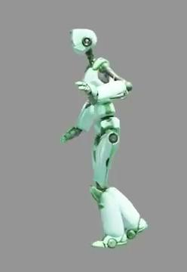
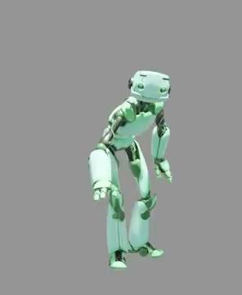
Inbetweening - Blending
✅
- More correlated
Notes:
Value I provided:
Showed HuMoR is difficult & saved time & money for disney
Diffusion
Laid foundation of code for animation group to work on

Slide 47
Conclusion - Motion Diffusion
✅ General purpose
✅ Performant
✅ Interesting follow-up
❌ Foot sliding
❓Control over generation
Notes:
Value I provided:
Showed HuMoR is difficult & saved time & money for disney
Diffusion
Laid foundation of code for animation group to work on

Slide 48
Final Conclusion

Slide 49
Conclusion
❌ HuMoR
slow & difficult to extend
optimising a global sequence with local updates is tough
✅ Motion Diffusion
flexible
promising
interesting future
Notes:
Value I provided:
Showed HuMoR is difficult & saved time & money for disney
Diffusion
Laid foundation of code for animation group to work on

Slide 50
Questions, comments & more!

Slide 51
References
[LVC+ 21]
Jiaman Li, Ruben Villegas, Duygu Ceylan, Jimei Yang, Zhengfei Kuang, Hao Li, and Yajie Zhao. Task-generic hierarchical human motion prior using vaes. CoRR, abs/2106.04004, 2021.
[SMK22]
Sebastian Starke, Ian Mason, and Taku Komura. Deepphase: Periodic autoen- coders for learning motion phase manifolds. ACM Trans. Graph., 41(4), jul 2022.
[DKP+23]
Yuming Du, Robin Kips, Albert Pumarola, Subastian Starke, Ali Thabet, and Artsiom Sanakeyeu. Avatars grow legs: Generating smooth human motion from sparse tracking inputs with diffusion model, 2023.
[TCL22]
Jonathan Tseng, Rodrigo Castellon, and C. Karen Liu. Edge: Editable dance generation from music, 2022.
[TRG+ 22]
Guy Tevet, Sigal Raab, Brian Gordon, Yonatan Shafir, Daniel Cohen-Or, and Amit H. Bermano. Human motion diffusion model, 2022.
[RBH+ 21]
Davis Rempe, Tolga Birdal, Aaron Hertzmann, Jimei Yang, Srinath Sridhar, and Leonidas J. Guibas. Humor: 3d human motion model for robust pose estimation. In International Conference on Computer Vision (ICCV), 2021.
[HJA20]
Jonathan Ho, Ajay Jain, and Pieter Abbeel. Denoising diffusion probabilistic models. CoRR, abs/2006.11239, 2020.
Notes:
Value I provided:
Showed HuMoR is difficult & saved time & money for disney
Diffusion
Laid foundation of code for animation group to work on

Slide 52
Supplementary material

Slide 53
HuMoR - initial z error accumulation

Slide 54
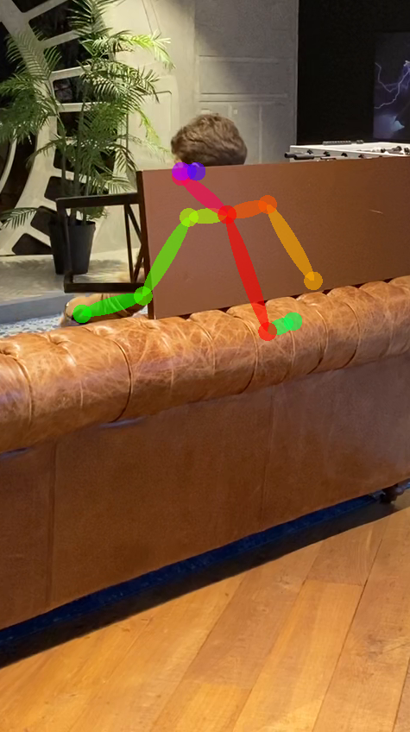
Optimisation
Motion Prior
Stage 1
Stage 2
+
Notes:
Value I provided:
Showed HuMoR is difficult & saved time & money for disney
Diffusion
Laid foundation of code for animation group to work on

Slide 55
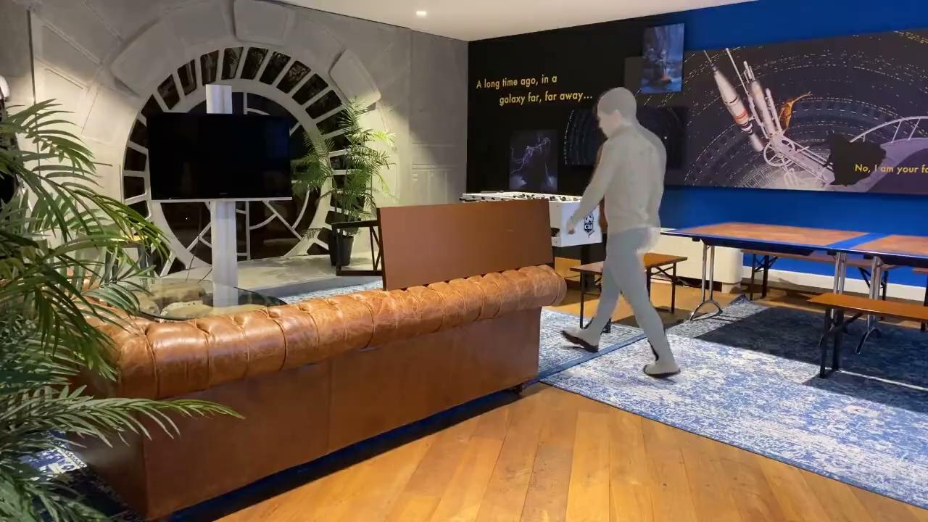

Rollout error accumulation
Initial x’s
Initial z’s
Notes:
Value I provided:
Showed HuMoR is difficult & saved time & money for disney
Diffusion
Laid foundation of code for animation group to work on

Slide 56
Diffusion - Model Architecture

Slide 57
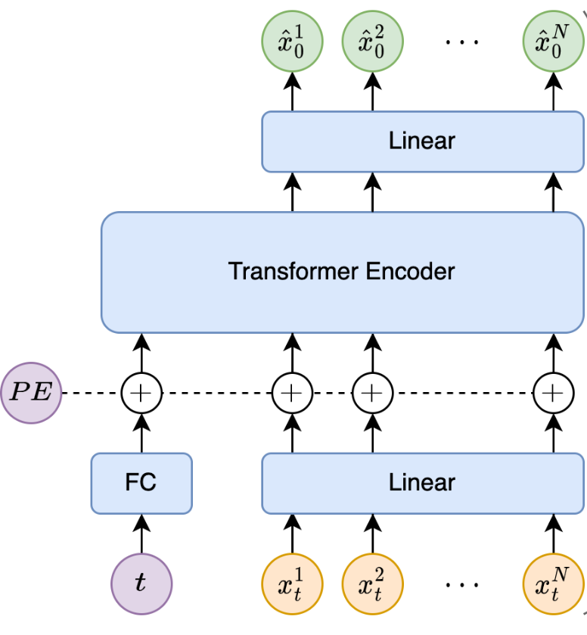
Denoising Network
Noisy motion in
Notes:
Value I provided:
Showed HuMoR is difficult & saved time & money for disney
Diffusion
Laid foundation of code for animation group to work on

Slide 58
Denoising Network
Clean motion out
Noisy motion in
Notes:
Value I provided:
Showed HuMoR is difficult & saved time & money for disney
Diffusion
Laid foundation of code for animation group to work on

Slide 59
Denoising Network
Clean motion out
How much noise? (timestep)
Noisy motion in
Notes:
Value I provided:
Showed HuMoR is difficult & saved time & money for disney
Diffusion
Laid foundation of code for animation group to work on

Slide 60
Diffusion - Denoising Procedure

Slide 61
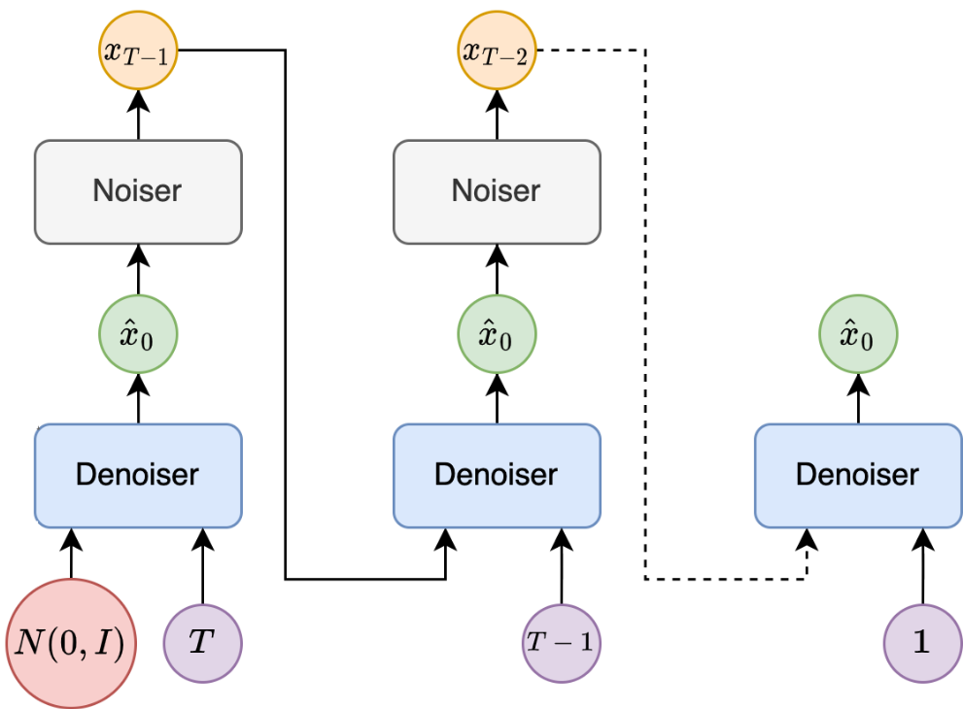
Denoising Procedure
Noise
Notes:
Value I provided:
Showed HuMoR is difficult & saved time & money for disney
Diffusion
Laid foundation of code for animation group to work on

Slide 62
Denoising Procedure
Predict clean signal
Noise
Notes:
Value I provided:
Showed HuMoR is difficult & saved time & money for disney
Diffusion
Laid foundation of code for animation group to work on

Slide 63
Denoising Procedure
Denoised one step
Predict clean signal
Noise
Notes:
Value I provided:
Showed HuMoR is difficult & saved time & money for disney
Diffusion
Laid foundation of code for animation group to work on

Slide 64
Denoising Procedure
Denoise one step
Repeat
Predict clean signal
Noise
Notes:
Value I provided:
Showed HuMoR is difficult & saved time & money for disney
Diffusion
Laid foundation of code for animation group to work on

Slide 65
Diffusion - Missing Joints

Slide 66
Missing Joints - 2
Remove 75% of orientations, fixed for all frames
❌
❌
❌
❌
❌
❌
❌
❌
❌
❌
❌
❌
❌
❌
❌
❌
❌
❌
❌
❌
❌
Frame 1
Frame 2
Frame 3
Notes:
Value I provided:
Showed HuMoR is difficult & saved time & money for disney
Diffusion
Laid foundation of code for animation group to work on

Slide 67
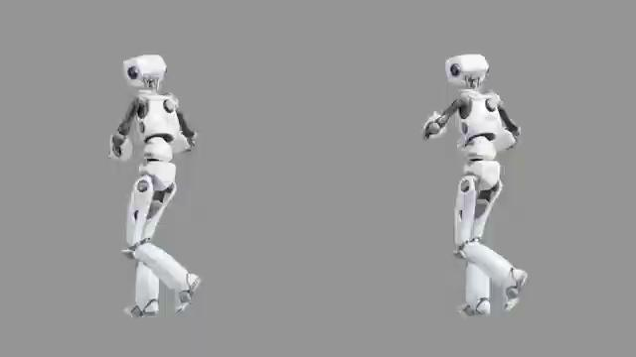
Missing Joints - 2 - Inpainting
❌
- Inpainting introduces
discontinuity as
prediction doesn’t
perfectly match
TODO: make shorter
Notes:
Value I provided:
Showed HuMoR is difficult & saved time & money for disney
Diffusion
Laid foundation of code for animation group to work on

Slide 68
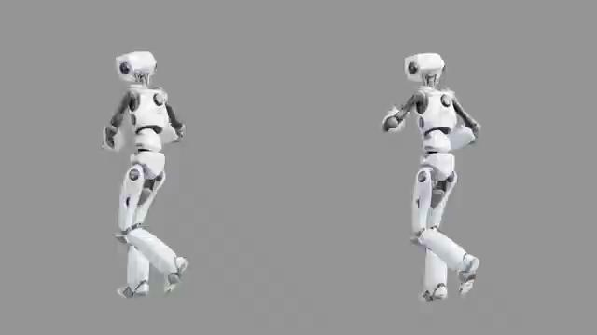
Missing Joints - 2 - Model Output
✅
- Smooth & Plausible
❌
- Known state doesn’t
match perfectly
❔
- Condition network to
avoid changing known
state
Notes:
Value I provided:
Showed HuMoR is difficult & saved time & money for disney
Diffusion
Laid foundation of code for animation group to work on

Slide 69
Diffusion - Denoising

Slide 70
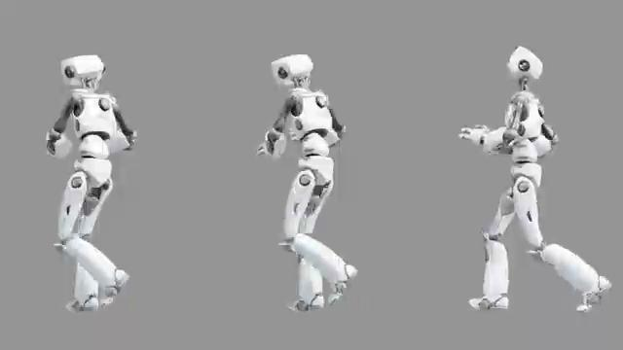
Denoising
✅
- Nice motion
❌
- Changes motion
❔
- Investigation
denoising procedure
more
Notes:
Value I provided:
Showed HuMoR is difficult & saved time & money for disney
Diffusion
Laid foundation of code for animation group to work on

Slide 71
Diffusion - Other Investigations

Slide 72
Other investigations - 1
World space root
Original data had fixed root in y plane
Result
Root motion uncorrelation with the rest
Foot sliding
Conclusion
Insufficient data to learn a world space root
Restricting the root space necessary
Notes:
Value I provided:
Showed HuMoR is difficult & saved time & money for disney
Diffusion
Laid foundation of code for animation group to work on

Slide 73
Other investigations - 2
Denoising procedure
Speed up denoising
1000 → 100 timsteps with little quality loss
Modified inpainting
Encourage consistency during inbetweening
Blend at the edges of the motion sequence
Use for autocompletion
Inpainting with fixed handles
Notes:
Value I provided:
Showed HuMoR is difficult & saved time & money for disney
Diffusion
Laid foundation of code for animation group to work on

